Slide 1
Chapter 8
Switching
8.<number>

Slide 2

Figure 8.1 Switched network
8.<number>

Slide 3

Figure 8.2 Taxonomy of switched networks
8.<number>

Slide 4
CIRCUIT-SWITCHED NETWORKS
Consists of a set of switches connected by physical links.
A connection between two stations is a dedicated path made of one or more links.
Each connection uses only one dedicated channel on each link.
Each link is normally divided into n channels by using FDM or TDM.
8.<number>

Slide 5
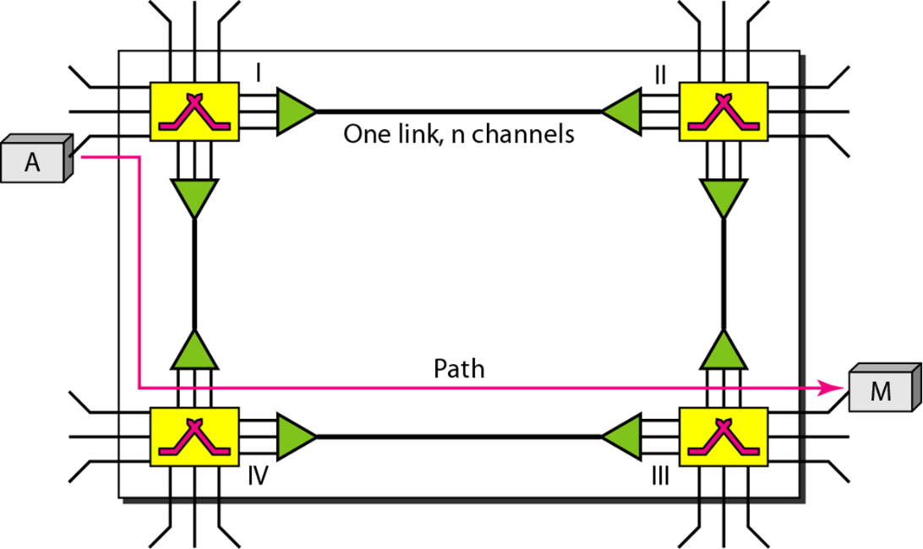
CIRCUIT-SWITCHED NETWORKS
The resources need to be reserved during the setup phase; the resources remain dedicated for the entire duration of data transfer until the teardown phase
8.<number>

Slide 6

Circuit-switched network
8.<number>

Slide 7

a circuit-switched network that connects computers in two remote offices
8.<number>

Slide 8

Figure 8.6 Delay in a circuit-switched network
Setup
Data Transfer
Tear down
8.<number>

Slide 9
Switching at the physical layer in the traditional telephone network uses
the circuit-switching approach.
8.<number>

Slide 10
8-2 DATAGRAM NETWORKS
In data communications, we need to send messages from one end system to another. If the message is going to pass through a packet-switched network, it needs to be divided into packets of fixed or variable size. The size of the packet is determined by the network and the governing protocol.
8.<number>

Slide 11

Figure 8.7 A datagram network with four switches (routers)
In a packet-switched network, there
is no resource reservation;
resources are allocated on demand.
8.<number>

Slide 12

Figure 8.8 Routing table in a datagram network
The destination address in the header of a packet in a datagram network
remains the same during the entire journey of the packet.
8.<number>

Slide 13

Figure 8.9 Delay in a datagram network
Switching in the Internet is done by using the datagram approach to packet switching at the network layer.
8.<number>

Slide 14
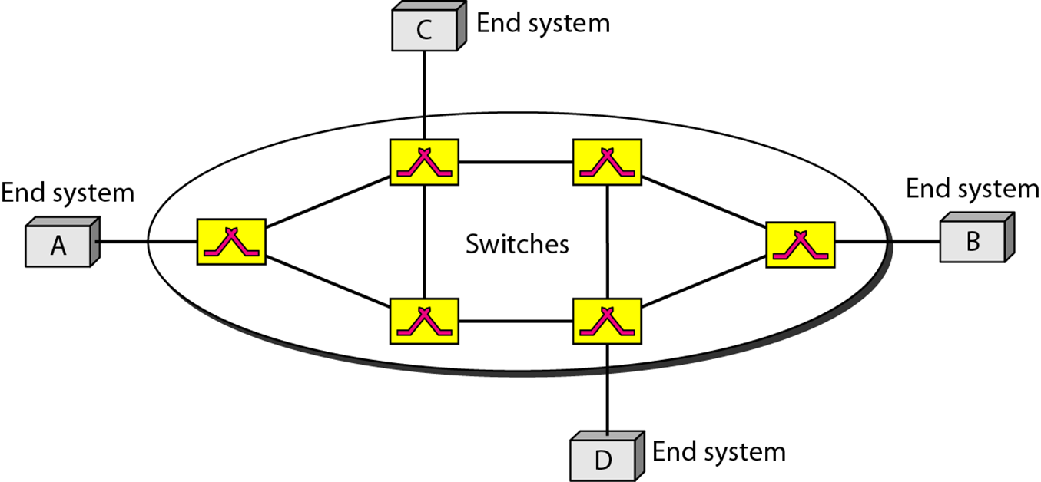
8-3 VIRTUAL-CIRCUIT NETWORKS
A virtual-circuit network is a cross between a circuit-switched network and a datagram network. It has some characteristics of both.
8.<number>

Slide 15

Figure 8.12 Switch and tables in a virtual-circuit network
8.<number>

Slide 16

Figure 8.13 Source-to-destination data transfer in a virtual-circuit network
8.<number>

Slide 17

Figure 8.14 Setup request in a virtual-circuit network
8.<number>

Slide 18

Figure 8.15 Setup acknowledgment in a virtual-circuit network
8.<number>

Slide 19

Note
In virtual-circuit switching, all packets belonging to the same source and
destination travel the same path;
but the packets may arrive at the destination with different delays
if resource allocation is on demand.
8.<number>

Slide 20

Figure 8.16 Delay in a virtual-circuit network
8.<number>

Slide 21
Note
Switching at the data link layer in a switched WAN is normally
implemented by using
virtual-circuit techniques.
8.<number>

Slide 22
STRUCTURE OF A SWITCH
We use switches in circuit-switched and packet-switched networks.
Circuit Switches
  Space division switch
  Time division switch
Packet Switches
8.<number>

Slide 23
Space Division Switches:
a circuit switching technology in which a single transmission path is accomplished in a switch by using a physically separate set of crosspoints.
has high speed, high capacity, and nonblocking switches.
achieved by using crossbar switch.
8.<number>

Slide 24

Crossbar switch with three inputs and four outputs
A crossbar switch is a metallic crosspoint or semiconductor gate that can be enabled or disabled by a control unit.
The Crossbar switch is made by using the semiconductor
The number of crosspoints increases as the number of stations is increased. Therefore, it becomes very expensive for a large switch.
8.<number>

Slide 25

Multistage switch
Multistage Switch is made by splitting the crossbar switch into the smaller units and then interconnecting them.
It reduces the number of cross points.
If one path fails, then there will be an availability of another path.
8.<number>

Slide 26
In a three-stage switch, the total
number of crosspoints is
2kN + k(N/n)²
which is much smaller than the number of crosspoints in a single-stage switch (N²).
8.<number>

Slide 27
Example
Design a three-stage, 200 × 200 switch (N = 200) with
k = 4 and n = 20.
first stage we have N/n or 10 crossbars, each of size 20 × 4.
second stage, we have 4 crossbars, each of size 10 × 10.
third stage, we have 10 crossbars, each of size 4 × 20.
The total number of crosspoints is 2kN + k(N/n)², or 2000 crosspoints.
This is 5 percent of the number of crosspoints in a single-stage switch (200 × 200 = 40,000).
8.<number>

Slide 28
Blocking refers to times when one input cannot be connected to an output because, there is no path available between them as all intermediate path available between them are occupied.
For Non-Blocking switch,
According to the Clos criterion:
n = (N/2)^{1/2}
k > 2n – 1
Crosspoints ≥ 4N [(2N)^{1/2} – 1]
8.<number>

Slide 29
Example 8.4
Redesign the previous three-stage, 200 × 200 switch, using the Clos criteria with a minimum number of crosspoints.
let n = (200/2)^{1/2}, or n = 10.
k = 2n − 1 = 19.
first stage --> 200/10, or 20, crossbars, each with 10 × 19 crosspoints.
second stage, 19 crossbars, each with 10 × 10 crosspoints.
third stage, 20 crossbars each with 19 × 10 crosspoints.
The total number of crosspoints is 20(10 × 19) + 19(10 × 10) + 20(19 ×10) = 9500.
8.<number>

Slide 30
Time Division Switching
incoming and outgoing signals received and re-transmitted in a different time slot.
TSI (time-slot interchange)
  is the most popular technology in a time-division switch.
  used random access memory (RAM) with several memory locations.
  The RAM fills up with incoming data from time slots in the order received.
  Slots are then sent out in an order based on the decisions of a control unit.
8.<number>

Slide 31

Time-slot interchange
8.<number>

Slide 32
Time Space Time (TST) switches are a particularly useful configuration of switching elements providing both time and space translation between channels of Time Division Multiplexed (TDM) telecommunications transmission lines
A time space (ts) switch takes the outputs of several time-division switches
a speech sample input during a time slot may be sent to the output during a different time slot, which implies a delay between reception and transmission of a sample.
8.<number>

Slide 33

Figure 8.20 Time-space-time switch
8.<number>

Slide 34

Packet switch components
A packet switch has four components: input ports, output ports, the routing processor, and the switching fabric
8.<number>

Slide 35


An input port performs the physical and data link functions of the packet switch.
The output port performs the same functions as the input port, but in the reverse order.
The routing processor performs the function of table lookup in the network layer.
The switching fabric is responsible for moving the packet from the input queue to the output queue."
8.<number>

Slide 36
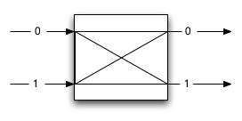
The Banyan Switch
Every packet (messages) that comes into the Banyan switch has a header that contains a bit indicating what its destination is (either 0 or 1).
The header is usually the first bit of the packet (message)
If the switch reads the bit and it has value 0, it sends the packet to its upper output (which is marked with 0 in the figure)
If the switch reads the bit and it has value 1, it sends the packet to its lower output (which is marked with 1 in the figure)
8.<number>

Slide 37

Figure 8.24 A banyan switch
8.<number>

Slide 38

Figure 8.25 Examples of routing in a banyan switch
8.<number>

Slide 39

Batcher-banyan switch
The Batcher network's comparators compare entire integer words instead of just individual bits as in the Banyan network.
sorts input packets in the order of their address values
guarantees no blocking in the succeeding
presents an efficient way to check contention.
The Banyan network distributes contention-free packets to their final destinations.
8.<number>

